Slide 1
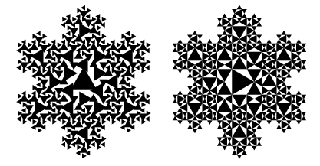
Fundamentals of Fractals
Main reference: [Hill] Computer Graphics uisng OpenGL (p472-477)

Slide 2

What are Fractals?
Fractal definition from MathWorld
  A fractal is an object or quantity that displays self-similarity, in a somewhat technical sense, on all scales.
  Fractals need not exhibit exactly the same structure at all scales, but the same "type" of structures must appear on all scales.

Slide 3

Self-Similarity Property of Fractal
Self similarity across scales
  As one zooms in or out the geometry/image has a similar (sometimes exact) appearance
  Types of self-similarity
    Exact self similarity
    Approximate self similarity
    Statistical self similarity

Slide 4
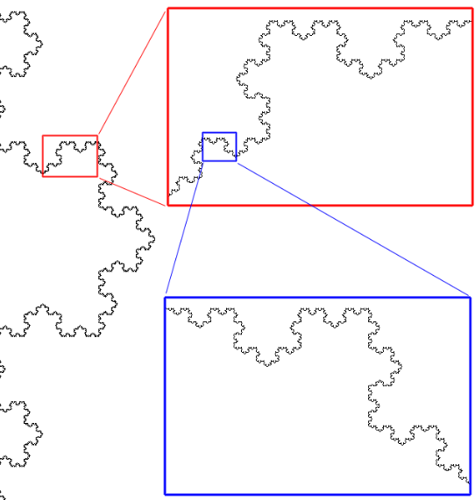
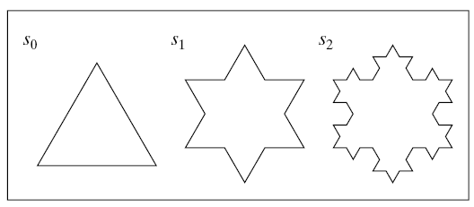
Exact Self-Similarity
Self similarity may be exact
  Normally only occurs in mathematically defined fractals
  Example:
  Koch snowflake

Slide 5
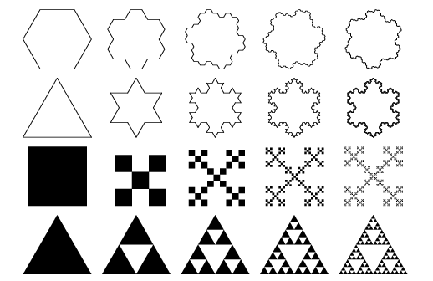
Exact Self-Similarity

Slide 6
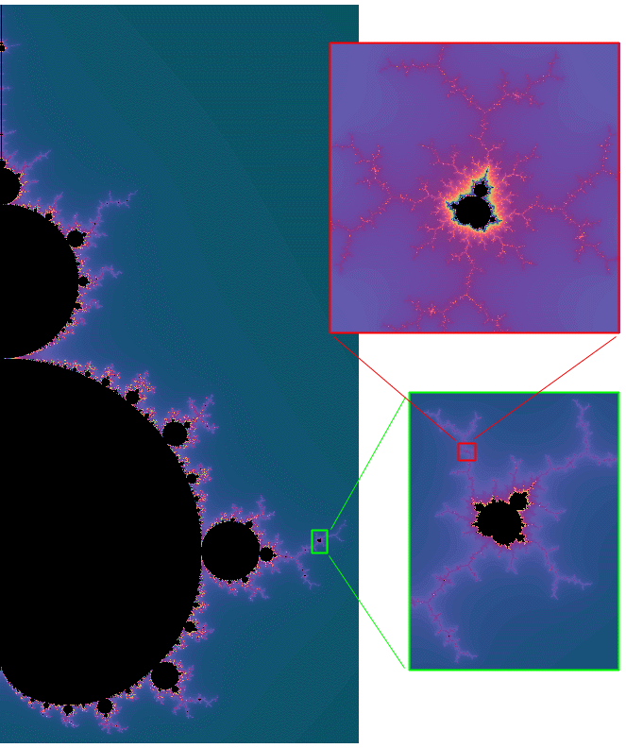
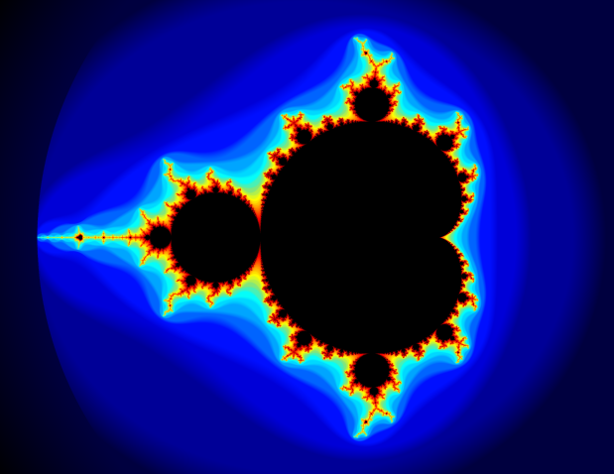
Approximate Self-Similarity
Structures that are recognizably similar but not exactly so
  More common type of
  self-similarity
  Example: Mandelbrot set
ITEPC 06 - Workshop on Fractal Creation

Slide 7
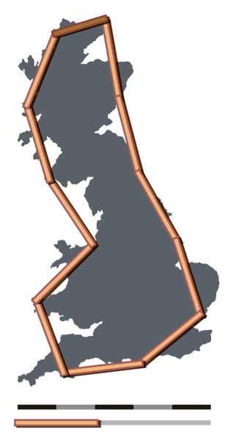
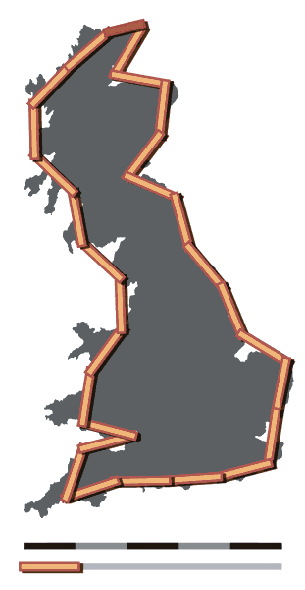
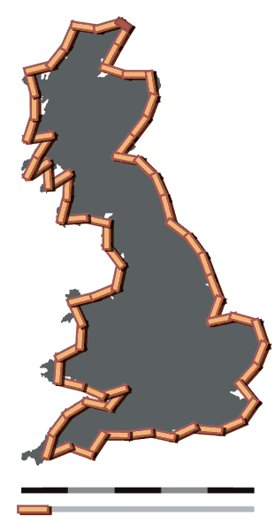
Statistical Self-Similarity
Irregularity is the same on the average
  Example: coastline

Slide 8
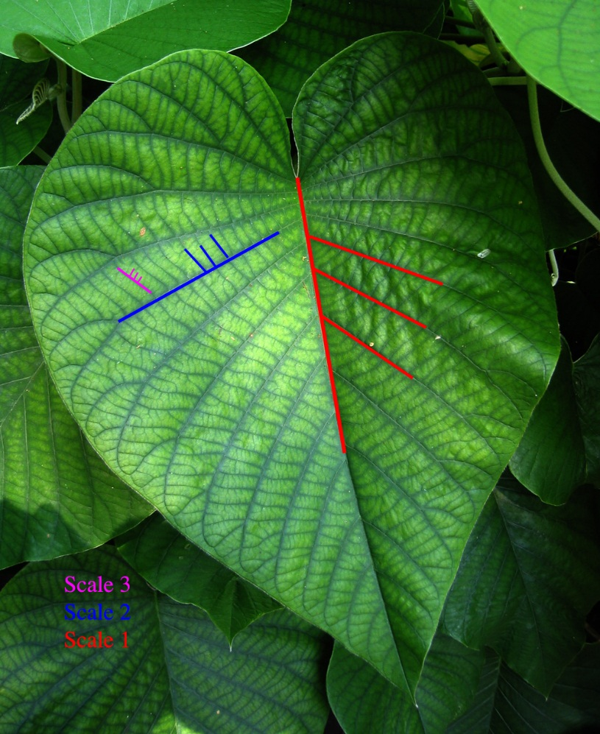
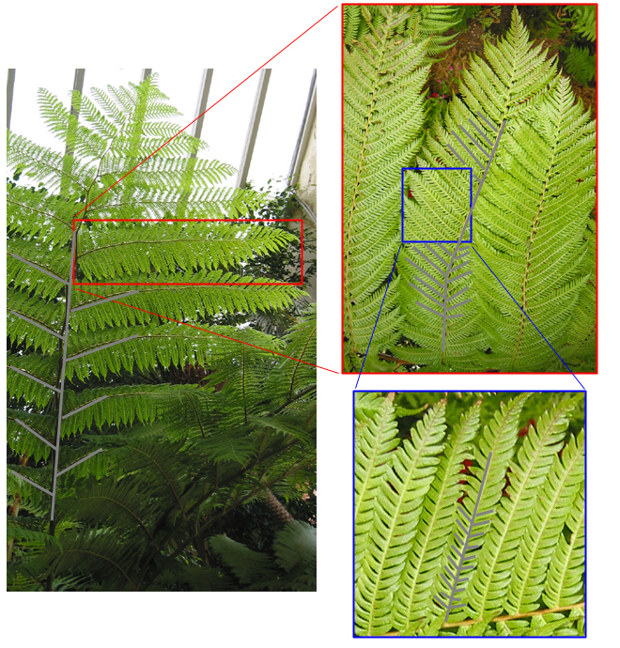
Self-Similarity in Real World

